Slide 1

CSC – 249 Group Project: Scrabble App
Collins Che Mbeuah
Chidozie Chukwuemeka
Zachary Deinhammer
James Dove

Slide 2
Scrabble App Overview
App designed to act as a Scrabble word checker:
Searches a Scrabble dictionary to see if a given word is valid.
Add news words to the Scrabble dictionary.
Remove words from the Scrabble dictionary.
Determines what valid words can be formed from a mixed list of characters.
Calculates the basic point value of any given word.

Slide 3
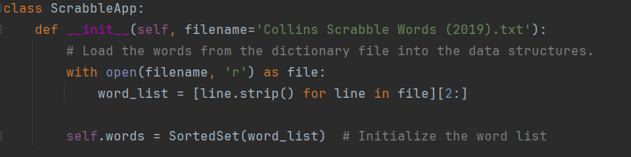
Constructor Method

Slide 4
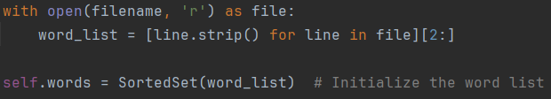
Constructor Method cont.
Creates the ScrabbleApp class and creates a sorted list out of a Scrabble dictionary text file.
Calls the constructor method with a parameter ‘filename’ set to the Scrabble dictionary used
Reads in the Scrabble dictionary, storing it in a sorted list

Slide 5
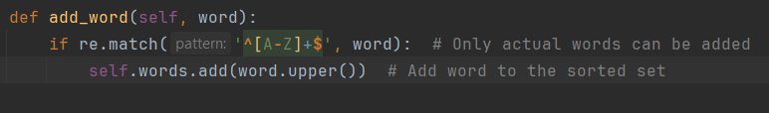
add_word Function

Slide 6
add_word cont.
Function designed to add a provided word to the overall Scrabble dictionary.
Establishes a parameter ‘word’ to be added to the dictionary
Checks to make sure only valid words, those containing only letters, are added to the dictionary
If the word is valid, it is converted to upper case then added to self.words

Slide 7
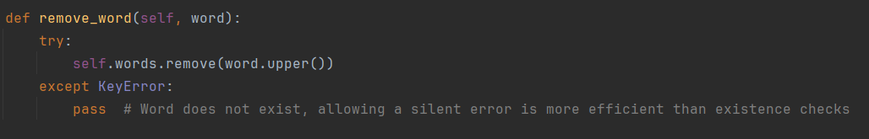
remove_word Function

Slide 8
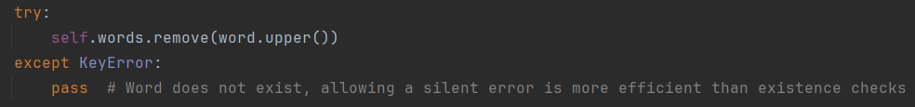
remove_word cont.
Allows the user to remove a provided word from the Scrabble dictionary.
Establishes a parameter ‘word’ which is to be removed from the dictionary
Within a try suite, the provided word is removed from self.words
If the word is not within the dictionary, a KeyError is raised, and the function is passed over

Slide 9
is_valid_word Function

Slide 10
is_valid_word cont.
Allows the user to check if a provided word is in the Scrabble dictionary self.words.
Establishes a parameter ‘word’ which is to be checked for membership in the dictionary
Checks to see if word, after being converted to upper case, is in self.words
Returns True if it is; False otherwise

Slide 11
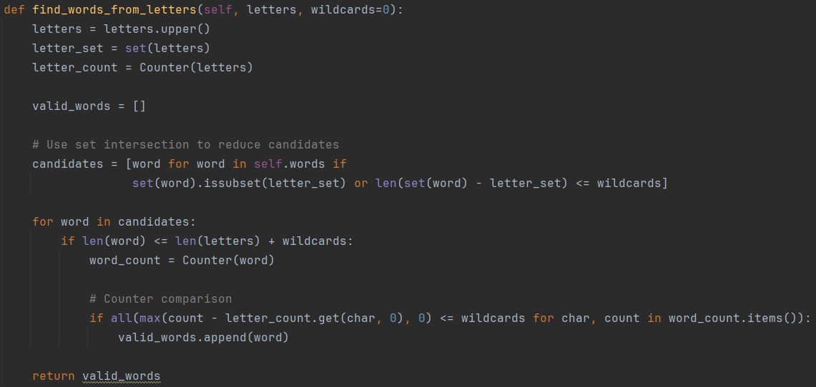
find_words_from_letters Function

Slide 12
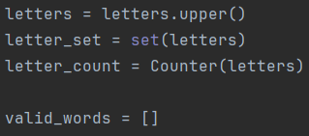
find_words_from_letters cont.
Allows the user to enter a group of unordered letters and determines what valid words can be formed from that list.
Establishes parameters ‘letters’, the group of characters to be turned into valid words, and ‘wildcards’ which is defaulted to 0
‘letters’ is converted to upper case for checking later with self.words
‘letters’ is converted to a set than assigned to variable name ‘letter_set’
An empty list is created with the name valid_words

Slide 13
find_words_from_letters cont.
A new list ‘candidates’ is established with a list comprehension
Iterates through each entry in self.words, checking if:
‘letter_set’ is a subset of word
Length of word – letter_set is <= wildcards

Slide 14
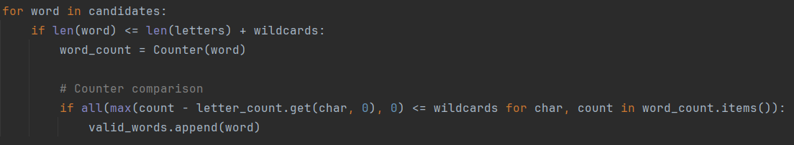
find_words_from_letters cont.
Iterates through each element in list ‘candidate’ created previously
More to be added here

Slide 15
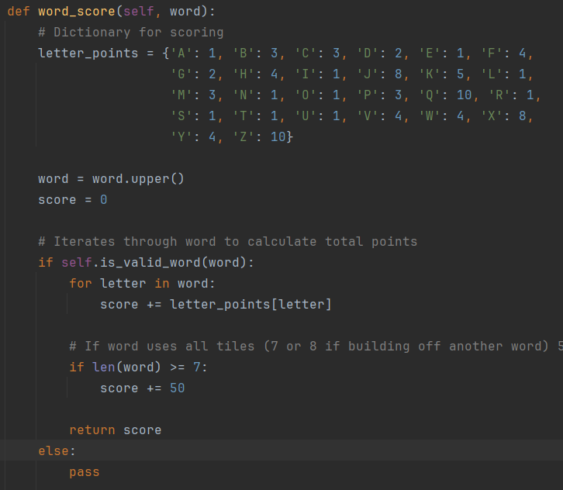
word_score Function

Slide 16
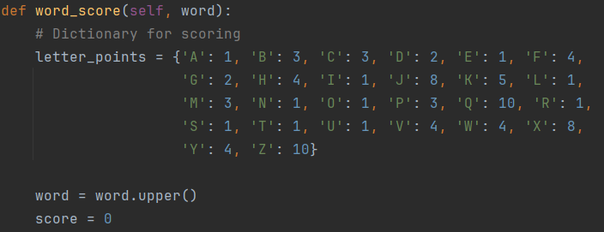
word_score cont.
Calculates the basic score of any word contained within the dictionary.
Establishes parameter ‘word’ which is to be scored
Sets up a dictionary with a key value pair of an alphabet letter and its associated score
Sets score equal to 0 for calculating the sum

Slide 17
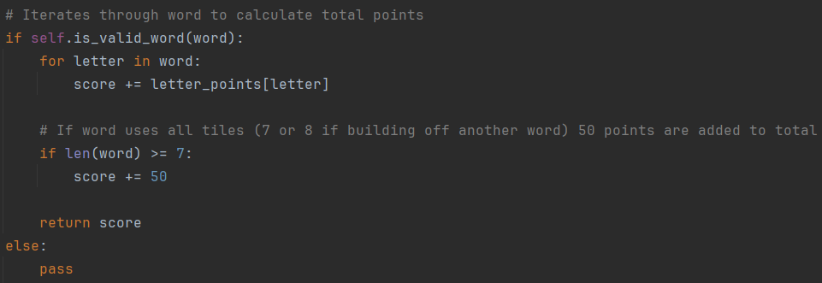
word_score cont.
Checks to see if the provided word is valid; if not, the function is passed over
If ‘word’ is valid, iterates through each letter and adds its corresponding point value in letter_points to the total
Adds an extra 50 points if a special condition is present

Slide 18
UI Placeholder

Slide 19
Conclusion Placeholder

